Slide 1
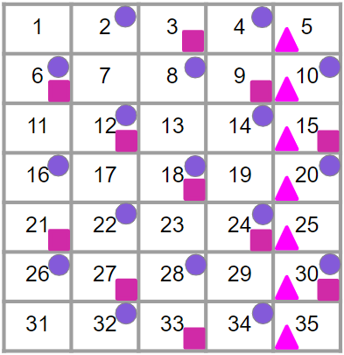
Checking understanding of factors, multiples, squares and cubes
Task A: Multiples
Using the grid:
Draw a circle next to all the multiples of 2
Draw a square next to all the multiples of 3
Draw a triangle next to all the multiples of 5
What the do the numbers with a circle and square represent?
Multiples of 2 and 3
What do the numbers with a circle, square and triangle represent?
Multiples of 2, 3 and 5

Slide 2


Checking understanding of factors, multiples, squares and cubes
Task B: Factors
Only using the following cards once, fill in the gaps.
14
7
11
22
is a multiple of
d) is a factor of
12
3
13
2
b) is a multiple of
e) only has factors
15
5
c) is a multiple of
2) Are the following always true, sometimes true or never true? When the answer is sometimes or never true, give an example
 | Always true | Sometimes true | Never true
Given A, B and C are integers A ✕ B = C C is a multiple of A and B A and B are factors of C
A multiple of a number is bigger than its largest factor |  | 5 is a multiple of 5 and 5 is a factor of 5
A product of two integers is an integer
1 is a factor of every integer
v2.2

Slide 3
Checking understanding of factors, multiples, squares and cubes
Task C: Square and cube numbers
Work out the unknown number given the clues.
a)
b)
I am less than 100
I am greater than 50
I am a square number
I am odd
I am a cube number
The sum of my digits is 9
I am a multiple of 9
I am less than 100
81
27
c)
I am a factor of 24
I am a multiple of 2
I am a number less than 10
I am a square number
d)
I am a cube number
I am a square number
I am a factor of every number
4
1
2) Complete the Venn diagram showing all the square and cube numbers up to 200.
Square numbers
Cube numbers
9
49
100
4
169
27
25
1
125
16
81
64
144
8
121
36
196
Mathematics in Education and Industry
‹#›
v2.2

